Slide 1
Wireless Coverage Resident Survey Results
Prepared By:
Prepared For:
Town of Dover Vermont

Slide 2
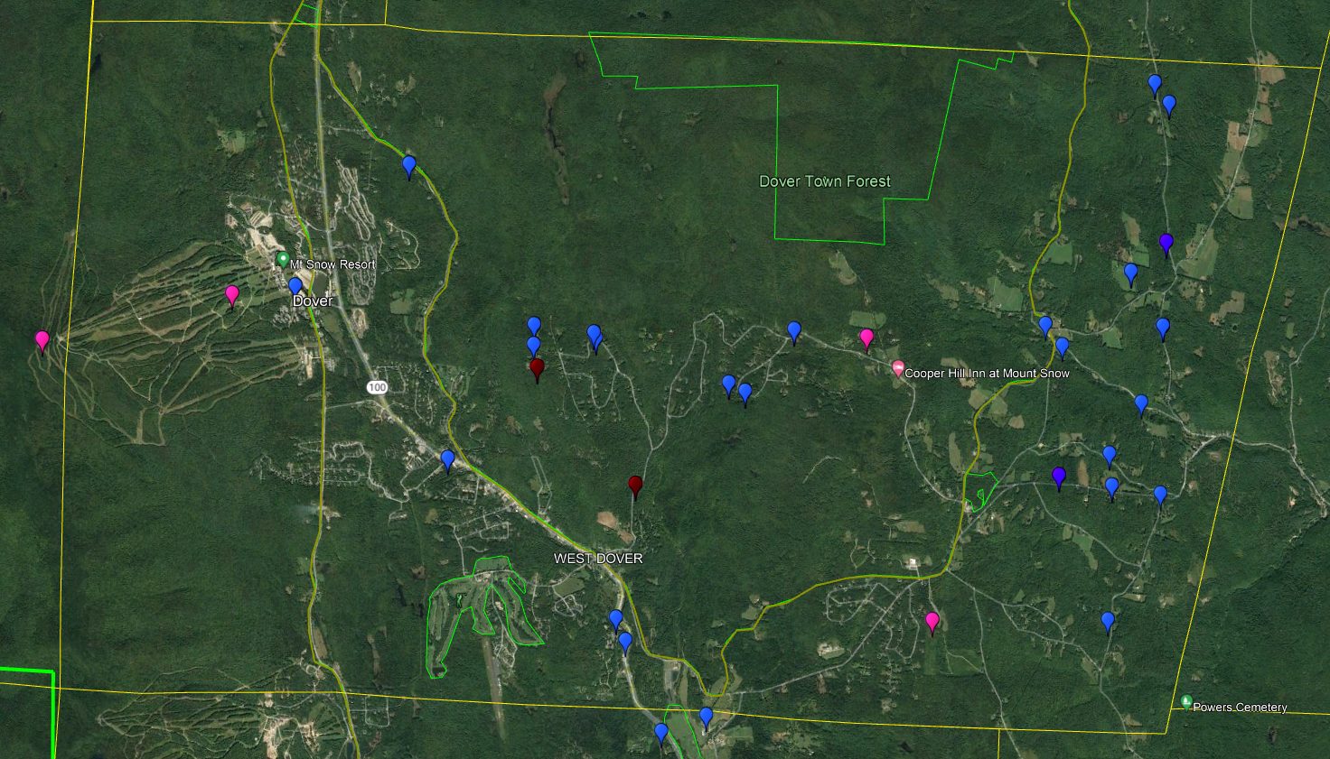
Town of Dover Results
Survey Dates:
August-October 2022
Total Submissions: 33
Complaint Breakdown:
Dropped Call: 6
No Coverage: 26
No Data: 1
Purple Pins / Dark Blue Pins – T-Mobile Light Blue Pins – AT&T
Red Pins – Verizon
Black Pins – US Cellular Pink Pins - Existing Cellular Sites

Slide 3
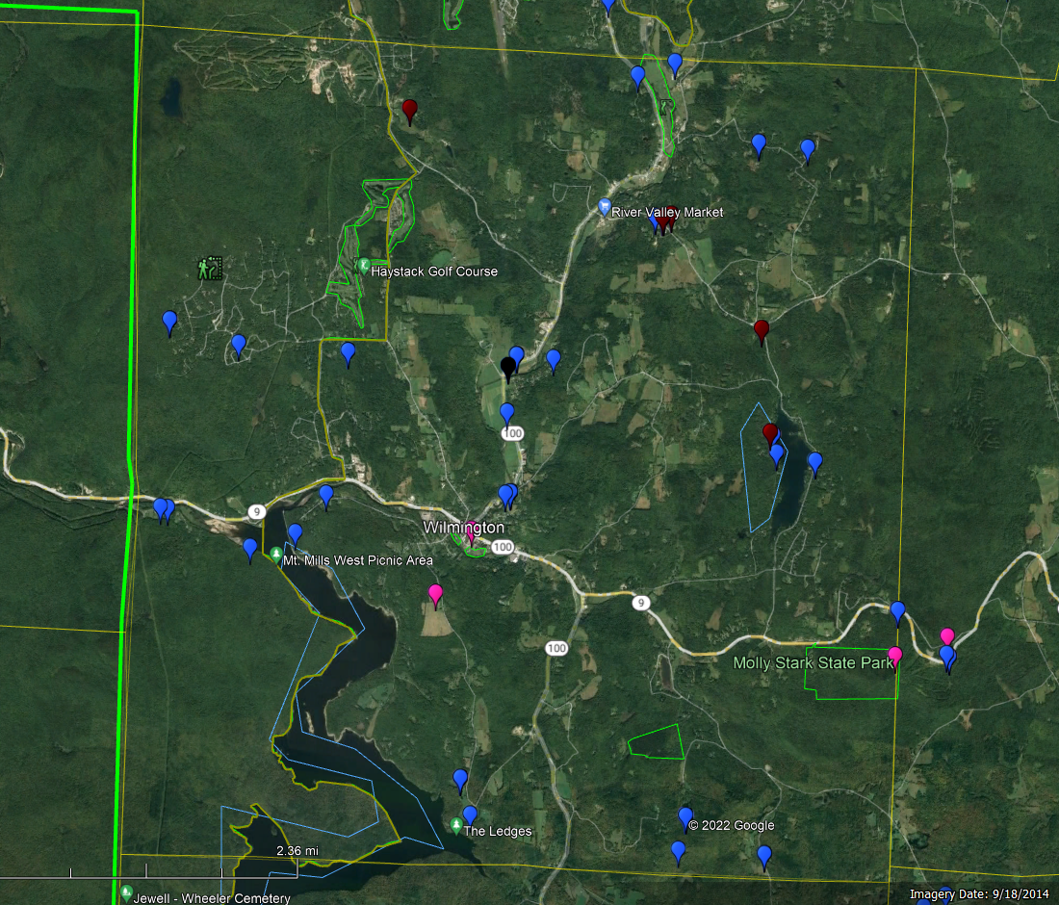
Town of Wilmington Results
Total Submissions: 46
Complaint Breakdown:
Dropped Call: 16
No Coverage: 26
No Data: 4
Purple Pins / Dark Blue Pins – T-Mobile Light Blue Pins – AT&T
Red Pins – Verizon
Black Pins – US Cellular Pink Pins - Existing Cellular Sites

Slide 4
Windham County Results
Data from 26 different towns received and a total of 289 data submissions
Purple Pins / Dark Blue Pins – T-Mobile Light Blue Pins – AT&T
Red Pins – Verizon
Black Pins – US Cellular Pink Pins = Existing Cellular Sites

Slide 5
Disclaimers
Any use by the Town of Palmer or anyone receiving a copy of this presentation must be in accordance with all applicable laws, as well as the Cell Coverage Mapping Privacy Policy, which can be found in the following link www.cellcoveragemapping.com . Any attempt to identify individuals providing information to CCM based upon their identified service coverage issue location is expressly prohibited.
The information provided herein is based on input from those voluntarily providing input to CCM. CCM has not taken any steps to independently verify whether the locations noted by consumers inputting information on their website correlates to areas with known coverage issues. As such, CCM makes no representations or warranties regarding the data except that it reflect the locations consumers responding to the CCM survey for the Town of Palmer have indicated where they have had cell coverage issues.
EXCEPT AS EXPRESSLY PROVIDED HEREIN, THE DATA IS PROVIDED "AS IS" AND CCM HEREBY DISCLAIMS ALL WARRANTIES, WHETHER EXPRESS, IMPLIED, STATUTORY, OR OTHERWISE. CCM SPECIFICALLY DISCLAIMS ALL IMPLIED WARRANTIES OF MERCHANTABILITY, FITNESS FOR A PARTICULAR PURPOSE, TITLE, AND NON-INFRINGEMENT. IN NO EVENT SHALL CCM HAVE ANY LIABILITY FOR ANY USE OF THE INFORMATION PROVIDED TO THE TOWN OF PALMER, OR ANY OTHER PERSON TO WHOM THE TOWN OF PALMER MAY PROVIDE THIS INFORMATION.
This report is Copyright 2021 Cell Coverage Mapping LLC, all rights reserved. Any use other than by the Town of Palmer for its internal informational purposes is expressly prohibited.

